Slide 1

CHOCOLATE FESTIVAL TÁBOR 15 -16 October 2016

Slide 2
WHY PARTICIPATE
AS AN EXHIBITOR ?
PROMOTION OF YOUR PRODUCTS TO PEOPLE WHO LOVE CHOCOLATE
PROMOTION AT A FESTIVAL HELD NOT IN SHOPPING MALL BUT IN A REPRESENTATIVE INTERIOR OF THE GREAT HALL OF HOTEL PALCÁT WITH CAPACITY UP TO 3,000 PEOPLE AT ONCE.
IN 2014 THE TOTAL NUMBER WAS 2,500 VISITORS – IN THE FIRST YEAR! 3,200 people came in 2015.
IT IS A SALES EVENT, WE DON’T PLAN ANY VOUCHERS INSTEAD OF MONEY – YOU ARE SELLING DIRECTLY TO THE END CUSTOMER AT PRICES THAT YOU SET – WE DON’T ASK FOR ANY FURTHER PERCENTAGE COMMISSION FROM YOUR SALES
WE WILL BUILD YOUR STALL – YOUR SALESPOINT – AND ALSO DISMANTLE IT – YOU CAN ARRIVE “LAST MINUTE”
YOU CAN GET A SPACE ON THE STAGE – TO PRESENT YOUR PRODUCTS ALONG WITH TASTING
YOU CAN GET A SLOT ON THE SCREEN TO ADVERTISE YOUR PRODUCTS
WE HAVE A SPECIAL OFFER OF ACCOMMODATION AT HOTEL PALCÁT – STAY RIGHT WHERE THE FESTIVAL TAKES PLACE. ENJOY A BONUS – INVITATION TO HOTEL WELLNESS.
WE RUN THE CHOCOLATE AND MARZIPAN MUSEUM, WHICH IS OPEN YEAR-ROUND WITH 50 THOUSAND VISITORS ANNUALLY AND WE OFFER LONG-TERM COLLABORATION (SUCH AS SELLING YOUR PRODUCTS)
WE RUN 2 CAFÉS – “CAFÉ BUDÍK” (AND OTHERS WILL OPEN SOON). WE OFFER YEAR-ROUND COLLABORATION – PRESENTATIONS, TASTINGS AND SPECIAL EVENTS FOR OUR CUSTOMERS.

Slide 3
PROMOTING THE FESTIVAL
- key activities
PR ARTICLES – FROM SEPTEMBER 2016
BILLBOARD CAMPAIGN – 5 BILLBOARDS September – October 2016
LED SCREENS (20 cities) – SPOT CAMPAIGN – from June 2016
DL FORMAT FLYERS – DISTRIBUTION TO INFORMATION CENTRES, MUSEUMS, CHOCOLATES, PRALINES, TRADE FAIRS, FOOD EVENTS – FROM DECEMBER 2015
PROMOTIONAL ACTION – „ZčokoLÁDUJTE SE!“ („ChocolateSTUFFed“) – interactive campaign on facebook with ticket sales – from November 2015. With viral video created for this occasion.
Media partners: radio Blaník (spot campaign), Mafra, Bauermedia, Stelevize, LED Multimedia, 4les advertising

Slide 4
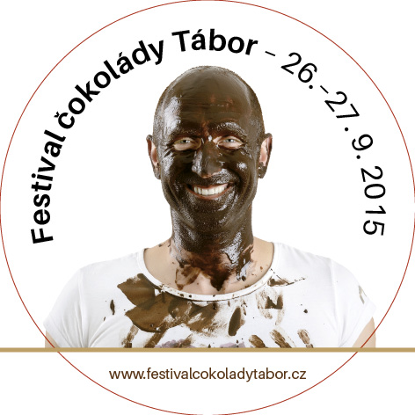
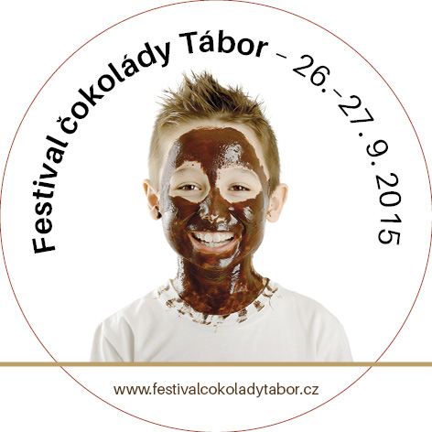
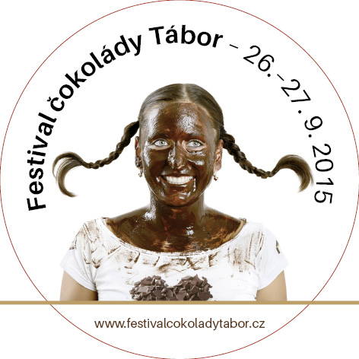
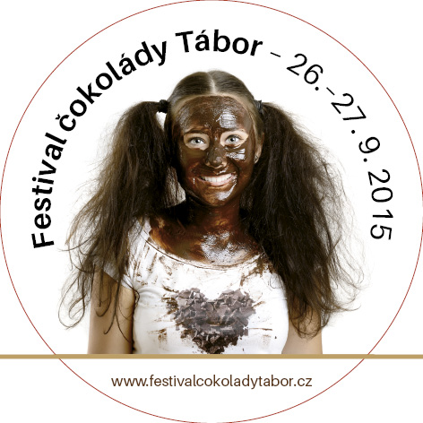
KEY PROMOTIONAL FEATURES: CHOCOLATE HEADS

Slide 5




FESTIVAL CAMPAIGN VISUALS
FESTIVAL FOR ALL AGE GROUPS – NO ONE WILL GET BORED

Slide 6
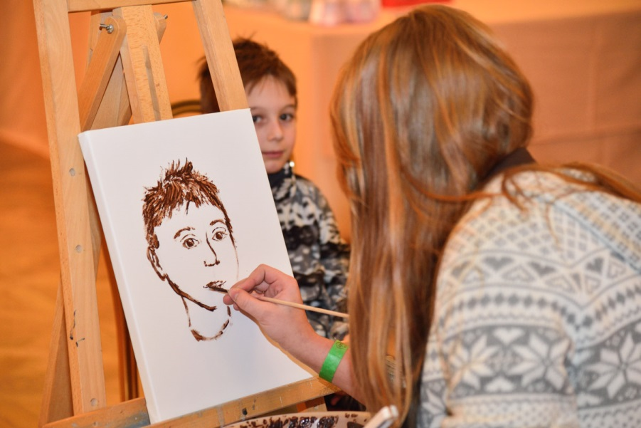
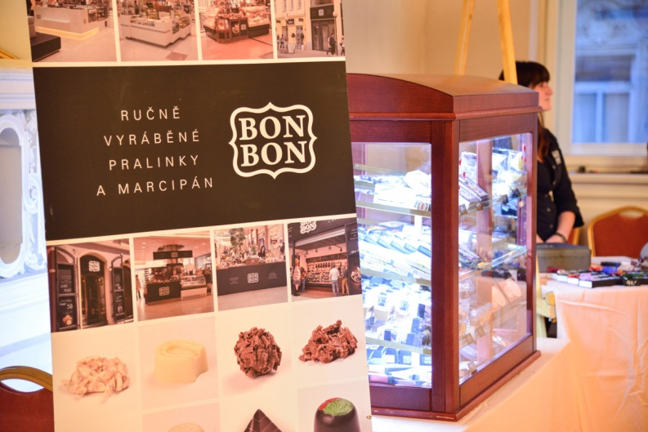
FESTIVAL PROGRAMME
CONCERTS
FAIRYTALES AND FUN FOR CHILDREN
FASHION SHOW – CHOCOLATE HATS
COMPETITION OF CONFECTIONERS
LIVE COOKING
CONFECTIONERY SHOW
TASTING TENT
SIMPLE WORKSHOPS – WORKING WITH CHOCOLATE
PLAY AREA
PRESENTATIONS AND TASTINGS …….
….. MORE DETAILS ON www.festivalcokoladytabor.cz

Slide 7
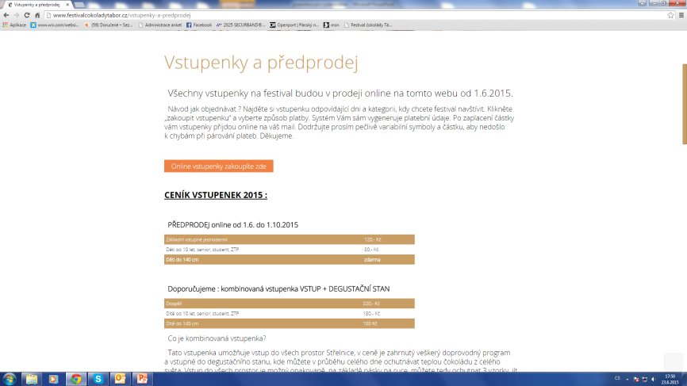
TICKETS
ONLINE EARLY BIRD TICKETS AVAILABLE FROM November 2015 ON THE FESTIVAL WEBSITE
SALES THROUGH THE „ZčokoLÁDUJTE SE!“ action – 5,000 tickets
Prices:
Children up to 140 cm height go free
Early bird online tickets until 30 March CZK 80
On-site ticket: CZK 190

Slide 8
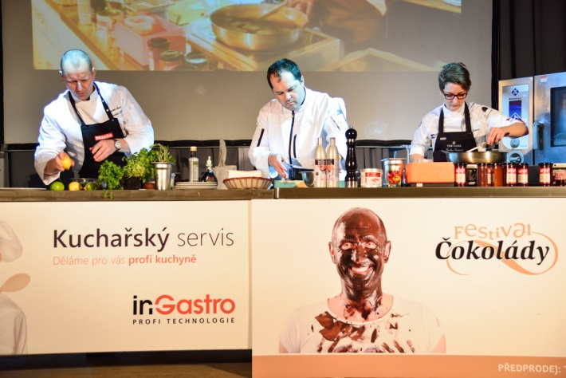
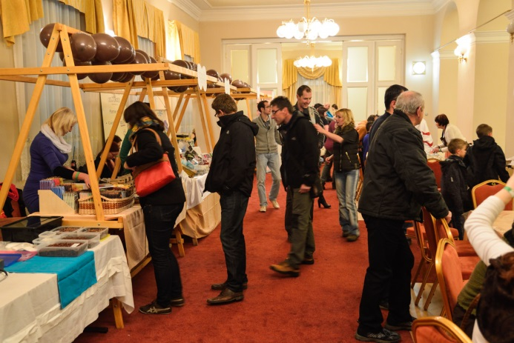
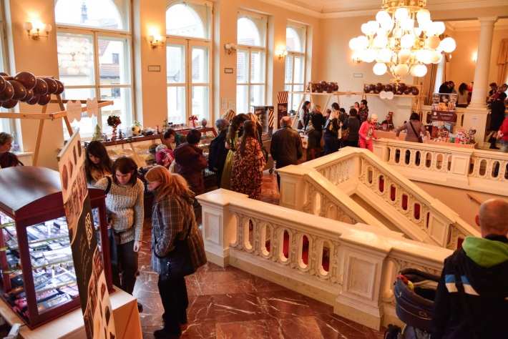
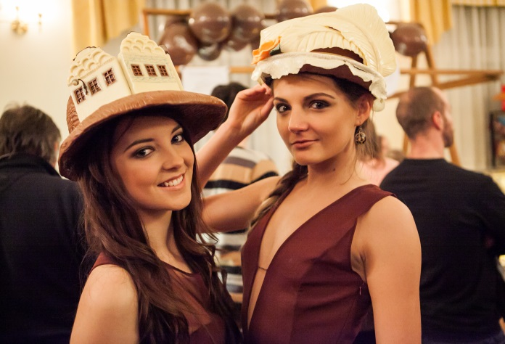
GALLERY – MORE on the festival website www.festivalcokoladytabor.cz

Slide 9
Conditions for exhibitors
Exhibition stand rental for two days – CZK 5,000 including electricity, stand erection, installation and dismantling
Rental of 3 x 3 area to erect own stand – CZK 4,000 CZK
Rental of area over 9 m – CZK 450 per metre
Price includes all presentations at the festival (video and spoken). Presentation in the festival catalogue with logo and photograph – CZK 1,000. Standard presentation is included in the price of the rental.
The exhibitors shall observe all instructions given by the organizers and offer free tastings at their stands during the entire festival.
Rental fee is payable upon invoice issued after confirming participation. Rental fee payments are only accepted in advance.

Slide 10
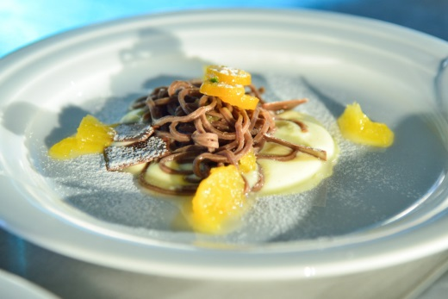
Still unsure?
Hurry up, places are limited
and only 35 salespoints are available.
1/3 of the places are already booked.
We will do our best to ensure perfect conditions for your presentation so that your trip to Tábor is a success - both business and social.
We plan to run the festival annually and we do hope
that you will reserve a stable date for it in your diary.

Slide 11

Contacts
Lenka Želivská
Festival woman of all trades ☺
Tel : +420 724 820 178
lenka.zelivska@festivalcokoladytabor.cz
www.festivalcokoladytabor.cz

